Slide 1
ECON251 Industry and Trade in Asia Lecture 03
The road to reforms
Inward Orientation
Introduction Video[ Until 2:06] : https://www.youtube.com/watch?v=mnjgjdwo-Gc

Slide 2
Key Objectives
Describe the main features of structuralist approach
Discuss and evaluate the import substitution strategies

Slide 3

Mainly by rich developed economies with funding
From topic 2:
Primary goods
Low GDP and growth
Unstable supply
Manufacturing goods
Engine of growth
Stable supply
Linkages
Smaller % of K and A
Higher % of K and A
Mainly by poor developing economies
Structural reforms
Dependency theory

Slide 4

Which sector should govt develop ?
Existing primary sector
New Secondary Sector
This Photo by Unknown Author is licensed under CC BY

Slide 5
Which sector should govt develop ?
Existing primary sector
Backward with low usage of k, poor infrastructure
Majority of the labour seeking employment in this sector

Slide 6
Issues and concerns
New Secondary Sector
Requires capital accumulation (K) – requires funding
Need infrastructure and support (electricity, water)
Lack of knowledge and experience
Labour supply issues
This Photo by Unknown Author is licensed under CC BY

Slide 7
Issues and concerns
New Secondary Sector
What type of manufacturing goods?
Will the locals buy or still purchase foreign imported goods
This Photo by Unknown Author is licensed under CC BY

Slide 8
The road to structural Reforms and Change
Via
STRUCTURALIST APPROACH
All decided by the government

Slide 9
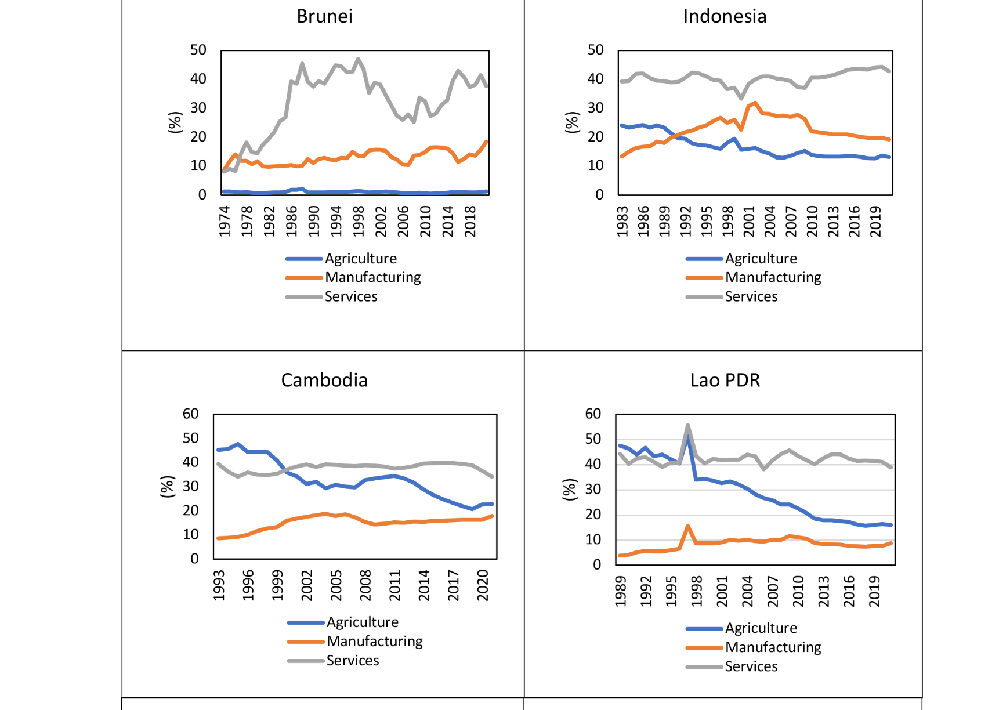
Sectoral Composition of GDP of selected Asia Economies
ADD on :
Exercise 1
Can you identify the Asia economy(s) that experienced
a structural change and the period it took place ?
Brunei experienced biggest structural change
Services increased sharply (from about 15% to over 40%
Agriculture fell to almost zero
This indicates a shift toward a service-based economy
Source: World Bank and CEIC.^{1, 2}

Slide 10
Development Strategies : Inward vs Outward
Inward orientation
Focus on domestic market
Outward Orientation
Focus on international market
Instead of importing, produce the manufactured product locally and promote consumption
Note: We are NOT discussing just on industrialisation but focus is it shuts off (except some aspects) from the world economy
Notes:
Structuralist Approach (all decided by Govt)
Inward Orientation = Focus on domestic markets
Set tariffs/quota to limit imports
Strengthen their currency (to make imports cheaper to buy more K (equipment, machines))
Government intervention
Cash grants (G rises)
Tax breaks (T falls)

Slide 11
Industry reforms – what’s ahead
Primary sector
Manufacturing sector
To develop the manufacturing sector in domestic market
Industrialisation
Inward Orientation
Growth strategies

Slide 12
Industry reforms – what’s ahead
Primary sector
Manufacturing sector
Also known as Import Substituting Strategies
Inward Orientation Growth strategies
Trade Protection
Overvalued currency
Limit trade
INWARD ORIENTATION GROWTH

Slide 13
2. Inward Orientation Growth strategies
The Strategies and evaluations

Slide 14

What is an Infant industry
The local manufacturing sector in the poor countries are usually small and undeveloped
Thus this industry is considered to be an INFANT INDUSTRY
This industry currently does not have comparative advantage and needs time to grow
Given trade protection, learning can take place and this industry can grow
This Photo by Unknown Author is licensed under CC BY

Slide 15

2.1 Trade protection and trade tools
Learning resource : https://www.investopedia.com/articles/economics/08/tariff-trade-barrier-basics.asp

Slide 16



Basics of trade : Simple Economics model
Case of no trade :
Local Supply : Q = 8P --eqn(1)
Local Demand : Q = 40 – 2P -- eqn (2)
P = 4
Local Demand = Local Supply at price P₀ of $4m and quantity of 32
The local farmers will be earning a revenue of $4 x 32 = $128
If the given price is $1 and the market clears, what is the level of imports ?
At p = 1
Qs = 8(1) = 8 (supply)
Qd = 40 – 2(1) = 38 (demand)
Since Demand > Supply, there is shortage
Imports = Qd – Qs = 38 – 8 = 30
Imports at world price of $1: 30 cars
Import always means Demand > Supply.
Import = Demand - Supply
Price ($/car)

Slide 17

Basics of trade : Simple Economics model
Case of trade : Import :
local demand { see point C) > Local supply (See point B)
This will occur if P lower than P0 ($4) where there will be a shortage of BC ; thus buyers will buy this amount overseas, known as import
So if P1 is given as $1k,
Local Supply Q= 8(1) = 8
Local Demand Q = 40 – 2(1) = 38
Shortage = 38 – 8 = 30
Import = 30
Qn: so if the government adopts the inward orientation approach that they want to produce the cars locally, and reduce imports, where must be the new price of cars ?
To eliminate imports completely, price must be >= 4.
At p = 4, Supply = 32, Demand = 32. There is no shortage at this price which will not require importing
Price ($/car)
Quantity of cars

Slide 18
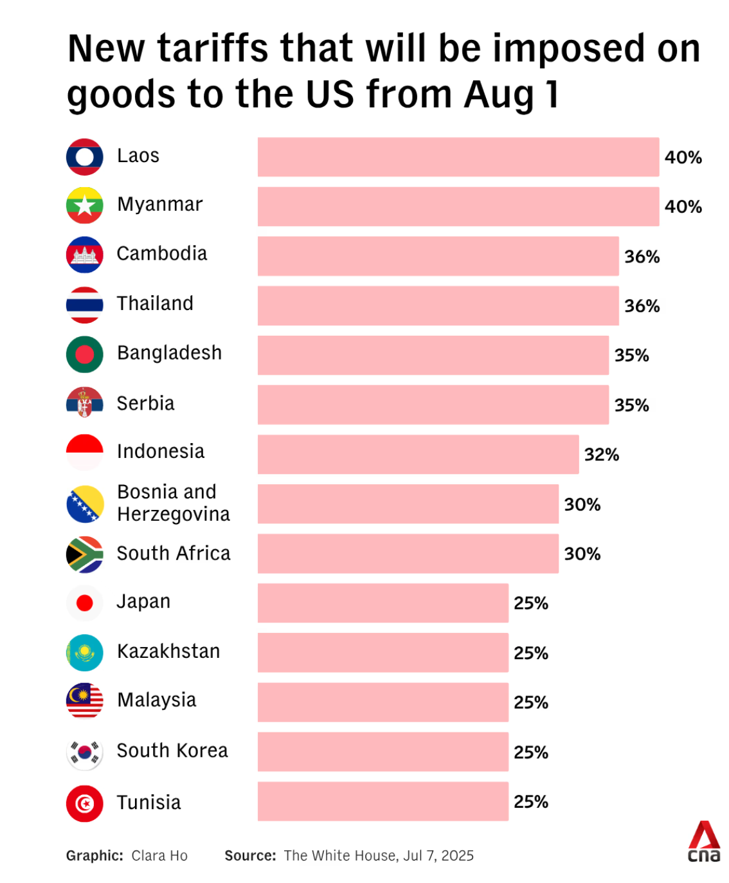
Tariffs

Slide 19
2.1.1 Protectionism Tools
World price of apples = $10/kg
Specific tax of $1 per kg
Ad valorem Tax of 20%
Tariff imposed = tax on imports
New price
$10 + $1 = $11
New price
$10 + 0.2X$10= $12
Aim : Reduce imports by increasing domestic price
Earned by govt

Slide 20


Effects of tariff
Case of free trade ( no tariff) : import : local demand > Local supply : example P1= $1, import = 30
Case of restricted trade : e.g $1 per item
New price = 1 + 1 (tax) = 2
Effect on local supply, Q1^{s} = 8(2) = 16
Effect on local demand , Q1^{d} = 40 – 2(2) = 36
Effect on import = 36 – 16 = 20
Change in import = 20 – 30 = -10
Effect on government (tax rev) = 1 x 20 = 20
New level farmer’s earnings =
PxQs = $2 x 16 = $32
Price ($)
Local Supply : Q = 8P --eqn(1)
Local Demand : Q = 40 – 2P -- eqn (2)
Qd 40 – 2p
Qs 8p
$2
$1
Shortage of 30 need to import 30
So tariffs on imported goods will shrink demand cuz consumers now have to pay $1 more and domestic producers (farmers) will earn more
8
16
36
38
Qty
Notes:
Tariffs will increase farmers revenue and will shrink demand

Slide 21

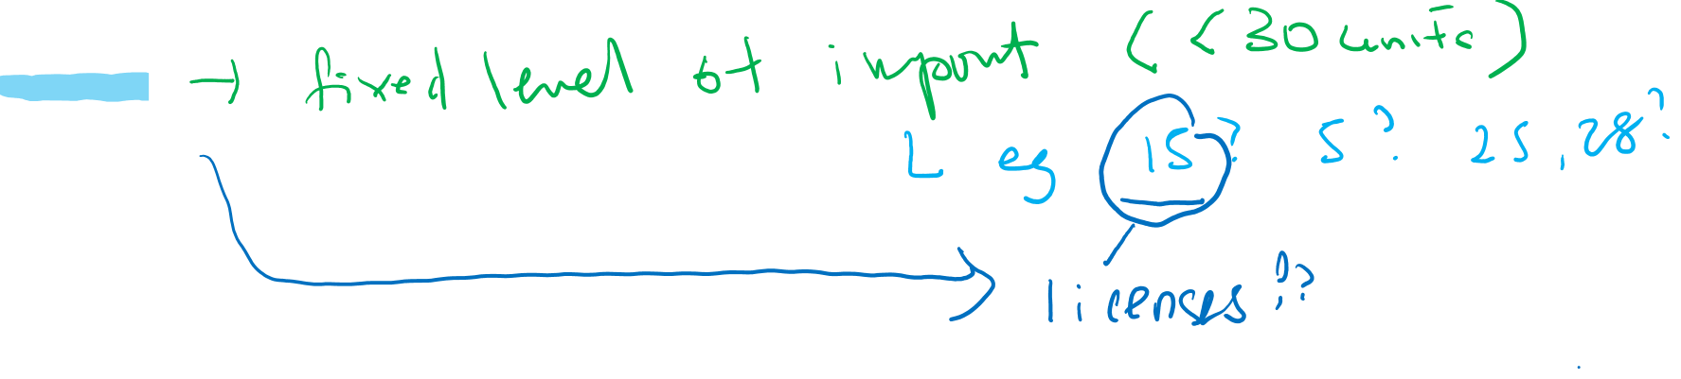
Protectionism acts
Quota
Notes:
Protectionist policy called a quota
A limit on imports
Limits the quantity of imports
Govt does not necessarily earn revenue
Prev example says at $1, imports were 30 cars
With a quota, the govt says u cannot import more than a certain no of cars
For example, instead of allowing 30 imported cars, the government might set:
Quota = 15 cars
or Quota = 25 cars
or Quota = 28 cars
The blue note circles 15 as an example.
Without a quota:
Domestic supply = 8
Domestic demand = 38
Imports = 30
With a quota of 15:
Only 15 imported cars are allowed
Consumers who cannot buy imported cars may buy local cars instead
The reduced supply in the market tends to push the price up
Domestic producers produce more because the higher price makes production more profitable.
License refers to import License
For example:
Company A gets a license to import 5 cars.
Company B gets a license to import 10 cars.
Together they can import only 15 cars.
This is why a quota is called a quantitative restriction on trade. It controls how many goods can enter the country, whereas a tariff controls the cost of importing them
Tariff
✔ Imports are still allowed.
✔ They become more expensive because of the tax.
Quota
✔ Imports are limited to a fixed quantity.
✔ Once the quota is reached, no more imports are allowed, regardless of how much consumers want to buy.

Slide 22
Effects of Quota (fixed quantity)
Local Supply : Q = 8P --eqn(1)
Local Demand : Q = 40 – 2P -- eqn (2)
Price ($)
Case of free trade ( no tariff) : import : local demand > Local supply : example P1= $1, import = 30
Import = (40-2(1)) – 8(1) = 30
Case of restricted trade
Quota = 10 = new import
How do we depict this restriction on the diagram? Next slide
Qd 40 – 2p
Qs 8p
$4
No trade
$1
Import = 30
8
32
38
Qty
Notes:
Case of restricted trade means instead of import 30, country only allows import of 10

Slide 23
Effects of Quota (fixed quantity)
Case of restricted trade
Quota = 10 = new import
Working backwards
Import = Demand – Supply
10 = (40-2p) – 8p
10 = 40 – 10p
10p = 30
p = 3
Government tax revenue = With a quota, there is no tariff, so $0
We will examine ad valorem tax in tutorial discussions
Local Supply : Q = 8P --eqn(1)
Local Demand : Q = 40 – 2P -- eqn (2)
Price ($)
Qd 40 – 2p
Qs 8p
$4
No trade
$3
Import = 10
$1
Change in import = 20 – 30 = -10
Import = 30
8
24
32
34
38
Qty

Slide 24
2.1.2 Effects of trade protection on domestic market
Reduce Local demand
Increase Local supply
there will be consumer who are forced to buy from domestic producers because of govt import controls
Lack or limited competition
Firms become complacent
Produce poor quality goods
Direct resources towards protected industries [ i.e. where prices rise more rapidly]
Effects
Notes:
With a quota:
Only limited import cars are allowed
Consumers who cannot buy imported cars may buy local cars instead
The reduced supply in the market tends to push the price up
Domestic producers produce more because the higher price makes production more profitable.

Slide 25
2.1.2 Effects of trade protection on domestic market
Reduce Local demand
Increase Local supply
Loss of consumer sovereignty : Choices: ‘forced to buy the more expensive and/or poor quality locally produced item

Slide 26
2.1.4 Effects of trade protection
Local production rises
Local consumption rises
RGDP
Rises
Restrict import vai tariffs
Govt collect more taxes
Increase govt spending
RGDP rises

Slide 27

2.2 . Inward Orientation Growth Strategies Overvalue local currency

Slide 28

2.3 . Inward Orientation and over valued currency
Effects of an OVER VALUED CURRENCY
-Example
Brazilian Real 1 = USD 0.20
Brazilian Real 1 = USD 0.40
In other words, the Brazilian govt will buy up the Local currency and sell USD [ imagine she has a pot of currency comprise of local and different foreign international currency]
Key Focus
Example : A metal cutting machine from USA cost USD 2000
Before revaluation , the Brazilian pay (2000/0.2) = 10, 000 real
With revaluation, the Brazilian pays (2000/0.4) = 5,000 real
A common practise by newly industrialised nations
Notes:
An overvalued currency means the local currency becomes stronger
This means 1 Real now buys twice as many US dollars.
So the Brazilian currency has appreciated (become stronger)
The machine becomes much cheaper for Brazilian firms.
This helps firms buy:
- Machines
- Technology
Equipment
These can improve productivity and help industrialization

Slide 29
2.3 . Inward Orientation and over valued currency
Effects of an OVER VALUED CURRENCY
A rise in imports where the strong local currency allows local firms to acquire intermediate goods , machinery for supporting the local production
But what if the US$ appreciates ?
1. That means the Brazilian govt will have to buy up more local currency with more US$ - Rapid depletion of reserves will land up in a currency crisis
Suppose investors around the world suddenly want more US dollars. USD demand go up and Brazilian real demand go down, to stop real from falling, Brazil need to intervene even more by buying even more reals and sell even more USD from its reserves leading to currency crsis
Key Focus

Slide 30
2.3.1 Inward Orientation and over valued currency
Key Problems
The country require reserves to maintain the exchange rate i.e. to buy up the local currency
This is the key challenge faced by poor developing countries

Slide 31

2.3 . Inward Orientation Growth Strategies Government assistance

Slide 32
2.4 . Govt assistance scheme
Tax Breaks
Government
payment to a
domestic producer
Low Interest
Loans
Cash Grants
Government
Equity
Participation

Slide 33

2.4.1 . Arguments government funding and assistance
High cash grants and subsidy = high government spending (G rises)
Low taxes or tax credit for firms (T falls)
Budget deficit
Note: Impact on government’s budget (= T – G) as T falls, G rises
Corruption ? Red tapes?
Case study : Latin America
Video Link: https://youtu.be/mnjgjdwo-Gc

Slide 34
A Quick summary
Industrialisation
Inward oriented approach
Trade restriction
Overvalue currency
Government support

Slide 35
Development Strategies : Inward vs Outward
All in all, these inward orientation industries of the structuralist approach failed.
Many researched showed the dismal economic performance of the Latin America economies
Now we consider the alternative – Outward Oriented approach which was adopted in the Asia economies
Inward orientation
Focus on domestic market
Outward Orientation
Focus on international market
Topic 04

Slide 36

3. An overview
Inward oriented Growth and development
Reforms
1) Trade reforms
2) Investment reforms
Outward Oriented Growth and Development
Trade liberalisation
This Photo by Unknown Author is licensed under CC BY-SA-NC
Notes:
Features of inward orientation
Govt planned and control
Trade restriction : limit imports and competition
FDI restriction
Currency manipulation

Slide 37
3.1 Outward Orientated growth
Also known as the NEOCLASSICAL Approach of theory of Industrialisation
Vs Structuralist approach [ Inward orientation + high degree of govt intervention]
Vs Structuralist approach
https://youtu.be/qUtv3PoRhhw

Slide 38
Reference
Bhattacharyya, S. And Williamson, J. G. (2009) Commodity Price Shocks and the Australian Economy since Federation, NBER Working Paper 14694, http://www.nber.org/papers/w14694
Love, J. (1983), Concentration, diversification and earnings instability, World Development, 11 (9), pp. 787-93.
Meier,M.G and Rauch,J.E. (2000), Leading Issues in Economic Development, Oxford University Press, Oxford (Chapter 4 & 5).
Pugel, T.A. (2004), International Economics, Irwin, USA (Chapter 6:116).
Weiss,J.(1988),Industry in Developing Countries, Routledge, London (Chapter 3).

Slide 39
Email : ckon@uow.edu.au
Send me an email if you have any issues or concerns on
The lesson today
Access to Moodle
Any errors you spotted in the course materials
Sharing a news or video resource
I will respond to you within 48 hours.

